Slide 1
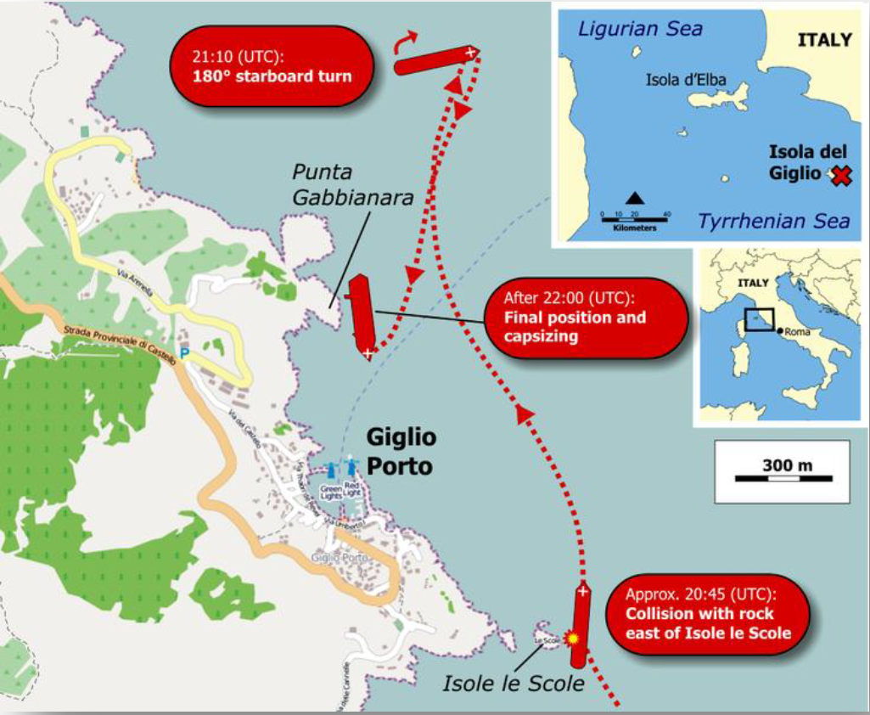
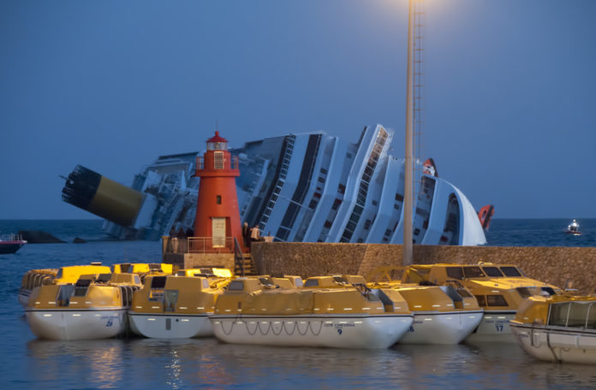
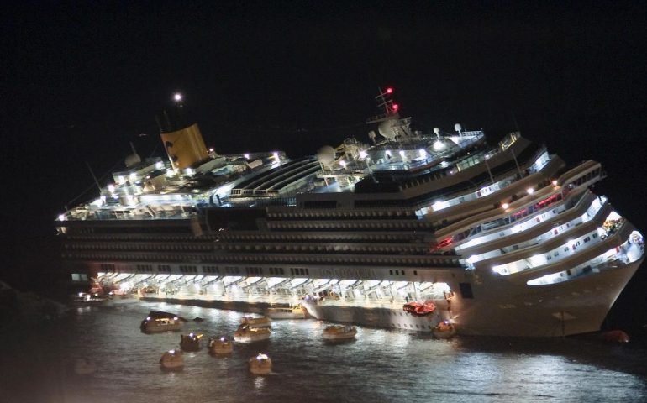

APPLICATION OF CAST to COSTA CONCORDIA ACCIDENT
CAST (Causal Analysis based on Systems Theory) is used to rationally elicit the cause of Costa Concordia accident.
BACKGROUND
13th January 2013
19:18 departure from Civitavecchia port to Savona.
Before departure a touristic sailing course was planned consisting in approaching Island of Giglio (Le Scole reef).
21:37 at a speed of 15.4 knots, the ship turns to starboard in order to make the passage close to the Island.
21:44 the maneuver was still ongoing, ship’s bow was heading to “Le Scole Reef” 0,3 miles off the rocks at a speed of 16 knots.
21.45 COLLISION between the port side of the hull and the eastern rock of “Le Scole reef”.
4,200 people rescued - 32 people died
COMPANY
SAFETY CONTROL STRUCTURE
MASTER
Contextual factors
Lack of adequate information from the Master about the emergency situation.
Financial pressure about accident liabilities.
Commercial pressure to safeguard the public image of the Company.
Failures, inadequate decisions, inadequate controls
Insufficient assessment/monitoring of the actual route of the ship.
Failure to ensure there are sufficiently qualified crew members on board to perform required duties, including facing emergencies.
Failure to provide oversight and feedback loops to ensure that each crew member is doing their job adequately.
Lack of proper deepening and assessment about the information received from the Master in order to support him and coordinate with the Emergency Team.
Contextual factors
Commercial push to increase passenger amusement.
The Master was on the phone with someone on shore asking suggestions about the navigation very close to the Island of Giglio.
Presence of strangers on the bridge.
Failures, inadequate decisions, inadequate controls
The Master acted beyond any planned procedure.
The Master was navigating too close to the shore.
The Master didn’t pay the adequate attention requested by the navigation close to the coast.
The Master didn’t order to close some open watertight doors during the navigation.
The Master didn’t take into consideration the First Officer’s suggestions.
The Master didn’t give the order to abandon the vessel in due time.
The Master didn’t manage the emergency on board and the evacuation process till the end.
The Master didn’t provide all the necessary information to the Company.
The Master didn’t provide all the necessary information to the Rescue Team Control Centre.
IMO
CLASS SOCIETY
FLAG STATE
COMPANY
PHYSICAL SYSTEM
RESCUE TEAM
MASTER
Systems involved in the loss
Navigation system.
Hull structure.
Internal subdivision.
Energy generation system.
Bilge pumping system.
Life saving appliances.
Failures and inadequate controls
Lack of acoustic and visual alarm to arise awareness about the decreasing of the depth and of the distance from the rocks.
Failure to provide the continuous working of the emergency generator.
Failure to provide electrical power for navigation and for emergency procedures (blackout).
Failure to power the high capacity service pumps and bilge pumps (blackout).
CREW
CREW
VESSEL
Contextual factors
Insufficient training.
The Master was willing to dare by all means.
The Master tried to underplay the actual situation.
The Master wasn’t incline to consider the other Officers’ advices.
Failures, inadequate decisions, inadequate controls
Bridge staff didn't warn the Master about the risk of his intentions and actions.
Bridge team didn’t use adequate cartography in relation with the type of navigation.
Bridge team didn’t use ECDIS set on an adequate representation scale.
Crew members didn’t close watertight doors during navigation.
Mental Model Flaws
Believe that the Master had the situation under control.
Lack of awareness about the risk of navigating too close to the shore.
Physical system
Positioning of vital equipment should be thought in terms of segregation and redundancy.
The suitable energy production and distribution system should be designed to be available in emergency cases.
Distribution along the length of the ship of bilge pumps and arrangement of high capacity pumps to drain huge quantities of water from an isolated compartment.
The emergency energy generation system should be redundant.
Acoustic and visual alarm to arise awareness about the decreasing of the depth and of the distance from the rocks should be integrated in the navigational system.
Flooding detection system should be provided on board.
Computerized program capable to provide direct information on the residual buoyancy and stability during the flooding should be provided on board.
Management system of the data collected from the flooding detection and monitoring system, on board stability computer and ballast/bilge systems should be implemented on board.
Socio-organizational system
The Master should not consider to change the route without a relevant reason.
An on-shore team and system should continuously monitor the position of the ship.
Information about navigational scenario should be integrated on board in order to automatically suggest the proper navigational chart scale (ECDIS).
The bridge team should be involved in the decision-making process carried on by the Master.
The Master of large passenger ships should undergo a specific training to manage emergency situations with specific focus on decision making and communication effectiveness.
The crew should be involved in a continuous training to face emergency situations, with specific reference to the Muster List (i.e. specific for crew members having safety tasks).
An evacuation analysis should be carried out at the early stage of the design.
Watertight doors should be always closed in navigation and opened exclusively when necessary and the risk of collision is low.
RECOMMENDATIONS
STAMP Workshop
C. Bongermino, P. Gualeni UNIGE-University of Genoa
costantino.bongermino@edu.unige.it paola.gualeni@unige.it
March 25-28, 2019 @MIT

